Slide 1
Global Mindmap
of
Reorganization Procedures
by R.J. de Weijs
June 2023
How to construct?
What are key questions?

Slide 2
Contracts can be altered or terminated
No cross-class
cram-down
Strict APR as to shareholders
NO PR as to shareholders
Contracts cannot be altered or terminated

Slide 3
What is APR?
Many interpretations
Application amongst creditors: relevant, but not the question today
Application to shareholders vis-a-vis creditors: focus of Mindmap
Baird & Jackson
‘When a firm owes more than its assets are worth, the shareholders receive nothing unless the creditors [as a class] consent’

Slide 4
Contracts can be altered or terminated
No cross-class
cram-down
Strict APR as to shareholders
NO PR as to shareholders
007
Contracts cannot be altered or terminated

Slide 5
How to fill out the diagram
Copy the correct national flag into slide 2.
Place the flag in the diagram on the right spot according to you.
If someone disagrees with the already placed spot, (s)he can place an additional flag on the deviating spot with his/her name on it.

Slide 6
Algeria
Argentina
Australia
Bahrain
Brasil
Canada
Cayman Islands
Chili
Colombia
[name]
[name]
[name]
[name]
[name]
[name]
[name]
[name]
[name]
[name]
[name]
[name]
[name]
[name]
[name]
[name]
[name]
[name]
[name]
[name]
[name]
[name]
[name]
[name]
[name]
[name]
[name]
[name]
[name]
[name]
[name]
[name]
[name]
[name]
[name]
[name]

Slide 7
Czech Republic
Denmark
Finland
France
Germany
Ghana
Greece
Guernsey
Hong Kong
India
[name]
Hélène and Reinhart
[name]
[name]
[name]
[name]
[name]
[name]
[name]
[name]
[name]
[name]
[name]
[name]
[name]
[name]
[name]
[name]
[name]
[name]
[name]
[name]
[name]
[name]
[name]
[name]

Slide 8
Ireland
Italy
Japan
Mexico
Netherlands
Nigeria
Norway
Poland
Russian fed.
Iacopo y Francesca
[name]
[name]
[name]
[name]
[name]
[name]
[name]
[name]
[name]
[name]
[name]
[name]
[name]
[name]
[name]
[name]
[name]
[name]
[name]
[name]
[name]
[name]
[name]
[name]
[name]
[name]
[name]
[name]
[name]
[name]
[name]
[name]
[name]
[name]
[name]
[name]
[name]
[name]
[name]
[name]
[name]
[name]
[name]
[name]
[name]
[name]
[name]
[name]
[name]

Slide 9
Singapore
South Africa
Spain
Switzerland
Uganda
UK
US
Venezuela
[name]
[name]
[name]
[name]
[name]
[name]
[name]
[name]
[name]
[name]
[name]
[name]
[name]
[name]
[name]
[name]
[name]
[name]
[name]
[name]
[name]
[name]
[name]
[name]
[name]
[name]
[name]
[name]
[name]
[name]
[name]
[name]
[name]
[name]
[name]
[name]
[name]
[name]
[name]
[name]
[name]
[name]
[name]
[name]
[name]
[name]
[name]
[name]
[name]
[name]
[name]
[name]
[name]
[name]
[name]
[name]
[name]
[name]
[name]
[name]
[name]
[name]
[name]
[name]
[name]
[name]
[name]
[name]
[name]
[name]
[name]
[name]
[name]
[name]
[name]
[name]
[name]
[name]
[name]
[name]
[name]
[name]
[name]
[name]
[name]
[name]
[name]
[name]
[name]
[name]
[name]
[name]
[name]
[name]
[name]
[name]
[name]
[name]
[name]
[name]
[name]
[name]
[name]
[name]

Slide 10
Amsterdam wonders III, the Game!
by Reinout Vriesendorp
June 2023

Slide 11
Amsterdam wonders III, the Game!
Objective: collaborate in a team (out of 24 teams) with approx. 9-10 fellow III delegates from across the world and with different backgrounds, led by a NextGen XI or XII Team Captain (TC), throughout the 2-day conference, to become acquainted with each other and to create more cohesion within III.
Method: TC and team members are requested to complete a team-questionnaire in combination with team and cross-team activities, requiring some professional and general knowledge (partially on Dutch peculiarities), social and intercultural skills for strategy and (team) tactics and, most importantly, a healthy sense of humor.
Finish: before the Closing Reception and during the Grand Finale Presentation and Awarding of Prizes to Game Winners, the winning team will be asked to come to the stage for the receipt of the prizes (with a Dutch taste). The winner will be the team with the highest number of well-performed Q&A (max. 16). In case of a draw, the most original and appealing responses to questions 1, 2, 10 and 14 according to the majority of the audience will determine the ultimate winner

Slide 12
Amsterdam wonders III, the Game!
Rules of Engagement and Dispute Resolution:
Participation means acceptance of any miracle or wonder, real (or potential) unexpected turn of events or other happening occurring to the team, as wonderful Amsterdam lessons learned
In the event of any unclarity, dispute of whatever kind during or after the game, miracles may occur, but lacking such miracle, the Quiz master, in its sole discretion, power and authority and by virtue of a full and final, binding order, will decide. Any form of appeal is excluded.

Slide 13
Amsterdam wonders III, the Game!
Some Q&A highlighted:
If you are a practitioner, ask an academically relevant question during the panel 1 discussion without mentioning your firm
If you are an academic, ask a practically relevant question during one of the other panels
If you are a judge, ask a clearly partisan question during one of the other panels

Slide 14
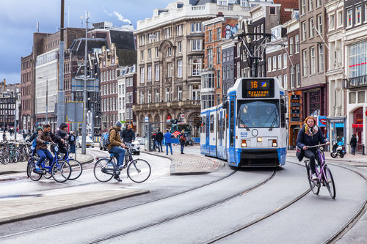
Amsterdam wonders III, the Game!
Some Q&A highlighted (cont’d):
If you are not from the Netherlands, please abstain from riding a bike, because many people from abroad have lost their battle with the tram tracks! Claim that you did not end up at first aid or ER (to be validated at the claim validation desk)

Slide 15
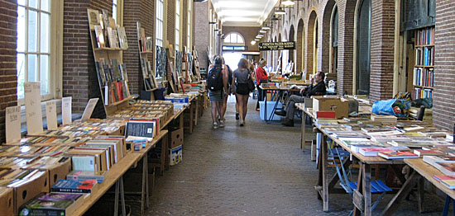
Amsterdam wonders III, the Game!
Some Q&A highlighted (cont’d):
Buy a book on the book market in front of the hall of OMPH (opening hours Sat. 10-16)

Slide 16
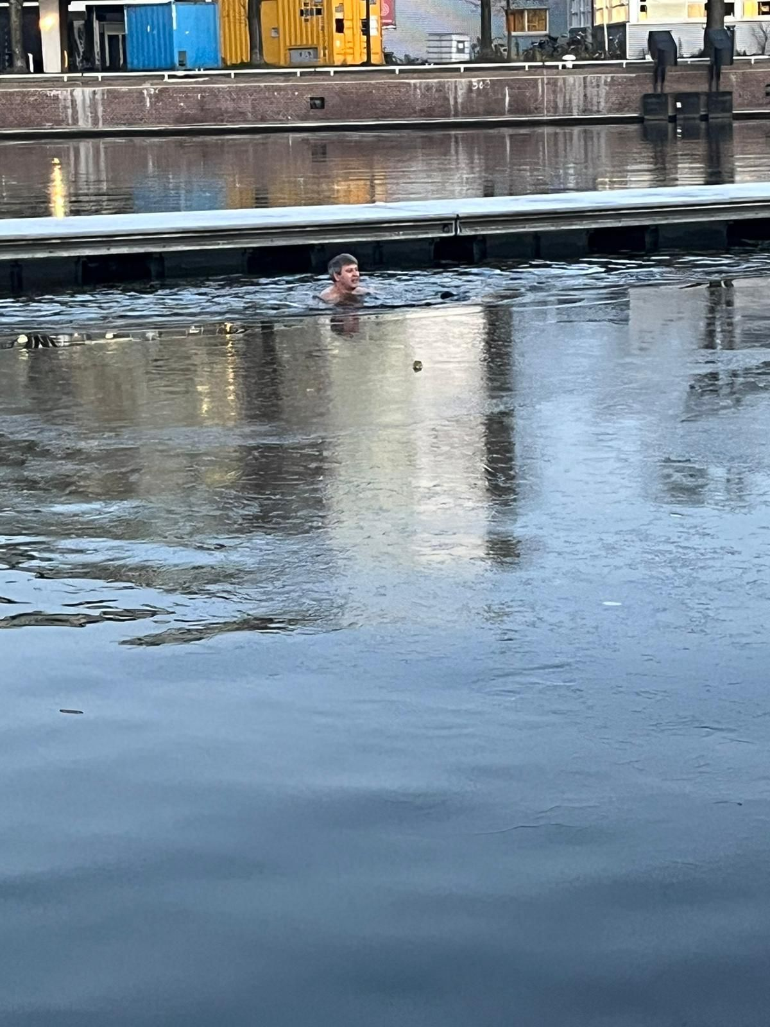
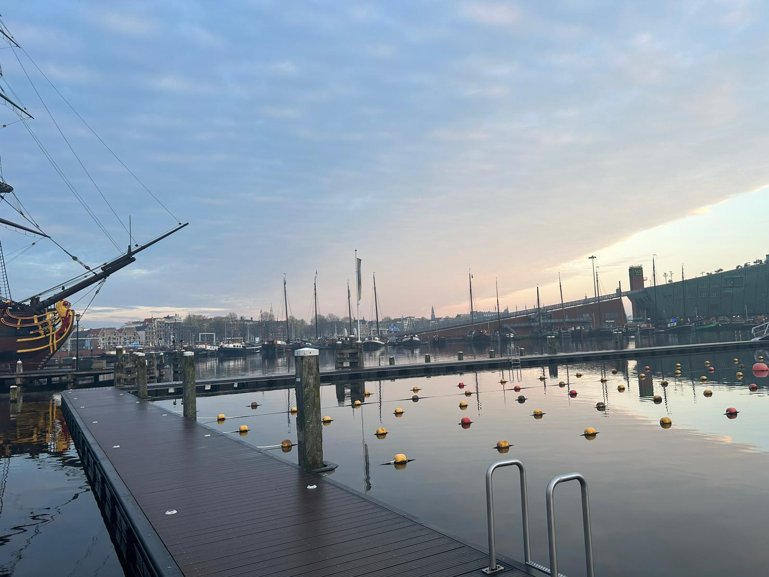
Amsterdam wonders III, the Game!
Some Q&A highlighted (cont’d):
Take a Sunday morning dip at the Marineterrein swimming facility close to the conference venue and take a modest selfie

